Slide 1
Integrated Self-Management Apps to Enhance Outcomes for Medicaid Consumers
Celeste Liebrecht, LMSW
Amy Kilbourne, PhD, MPH
Melvin McInnis, MD
Kelly Ryan, PhD

Slide 2
Life Goals Collaborative Care
Evidence-based, manualized psychosocial intervention (Bauer & McBride, 2003)
Includes health behavior change, psychotherapy, and motivational enhancement strategies
Helps persons with mental disorders achieve personal goals by linking them to tailored health behavior change and symptom coping strategies
Effectiveness shown in seven randomized controlled trials, especially for persons with co-occurring medical and substance use disorders
How can we disseminate this evidence-based practice so that it reaches more people?

Slide 3
PRIORI System Helping people manage symptoms with minimal assessment burden
Established system in testing phase
Continuously collect phone audio
Encrypt calls and send to server
Perform feature extraction
Machine learning to estimate mood

Slide 4
Michigan Mental Health Integration Partnership (MIP) FY18 Self-Management App Project Proposal
Goal: Decrease the digital divide: Disseminate innovative mobile applications (i.e. Priori; Life Goals) using smartphone technology
Enhance self-management support for individuals with mood disorders
Refine and disseminate Life Goals and PRIORI apps in CMHs
Both apps will be available at no cost
Project Objectives:
Objective 1: Refine the Life Goals and PRIORI apps (i.e. fixing bugs, incorporating link from one app to another) for use among consumers served by Medicaid

Slide 5
Objective 1: Life Goals Smartphone App
Self-guided Smartphone App covering the complete Life Goals module library (13 modules total within the app)
Interactive elements; app is tailored to the individual based on personal information that is “bookmarked” and referred to in later sessions
Ability to alert/prompt consumer to check in with their provider (alerts are based on consumer response to Smartphone App content)

Slide 6
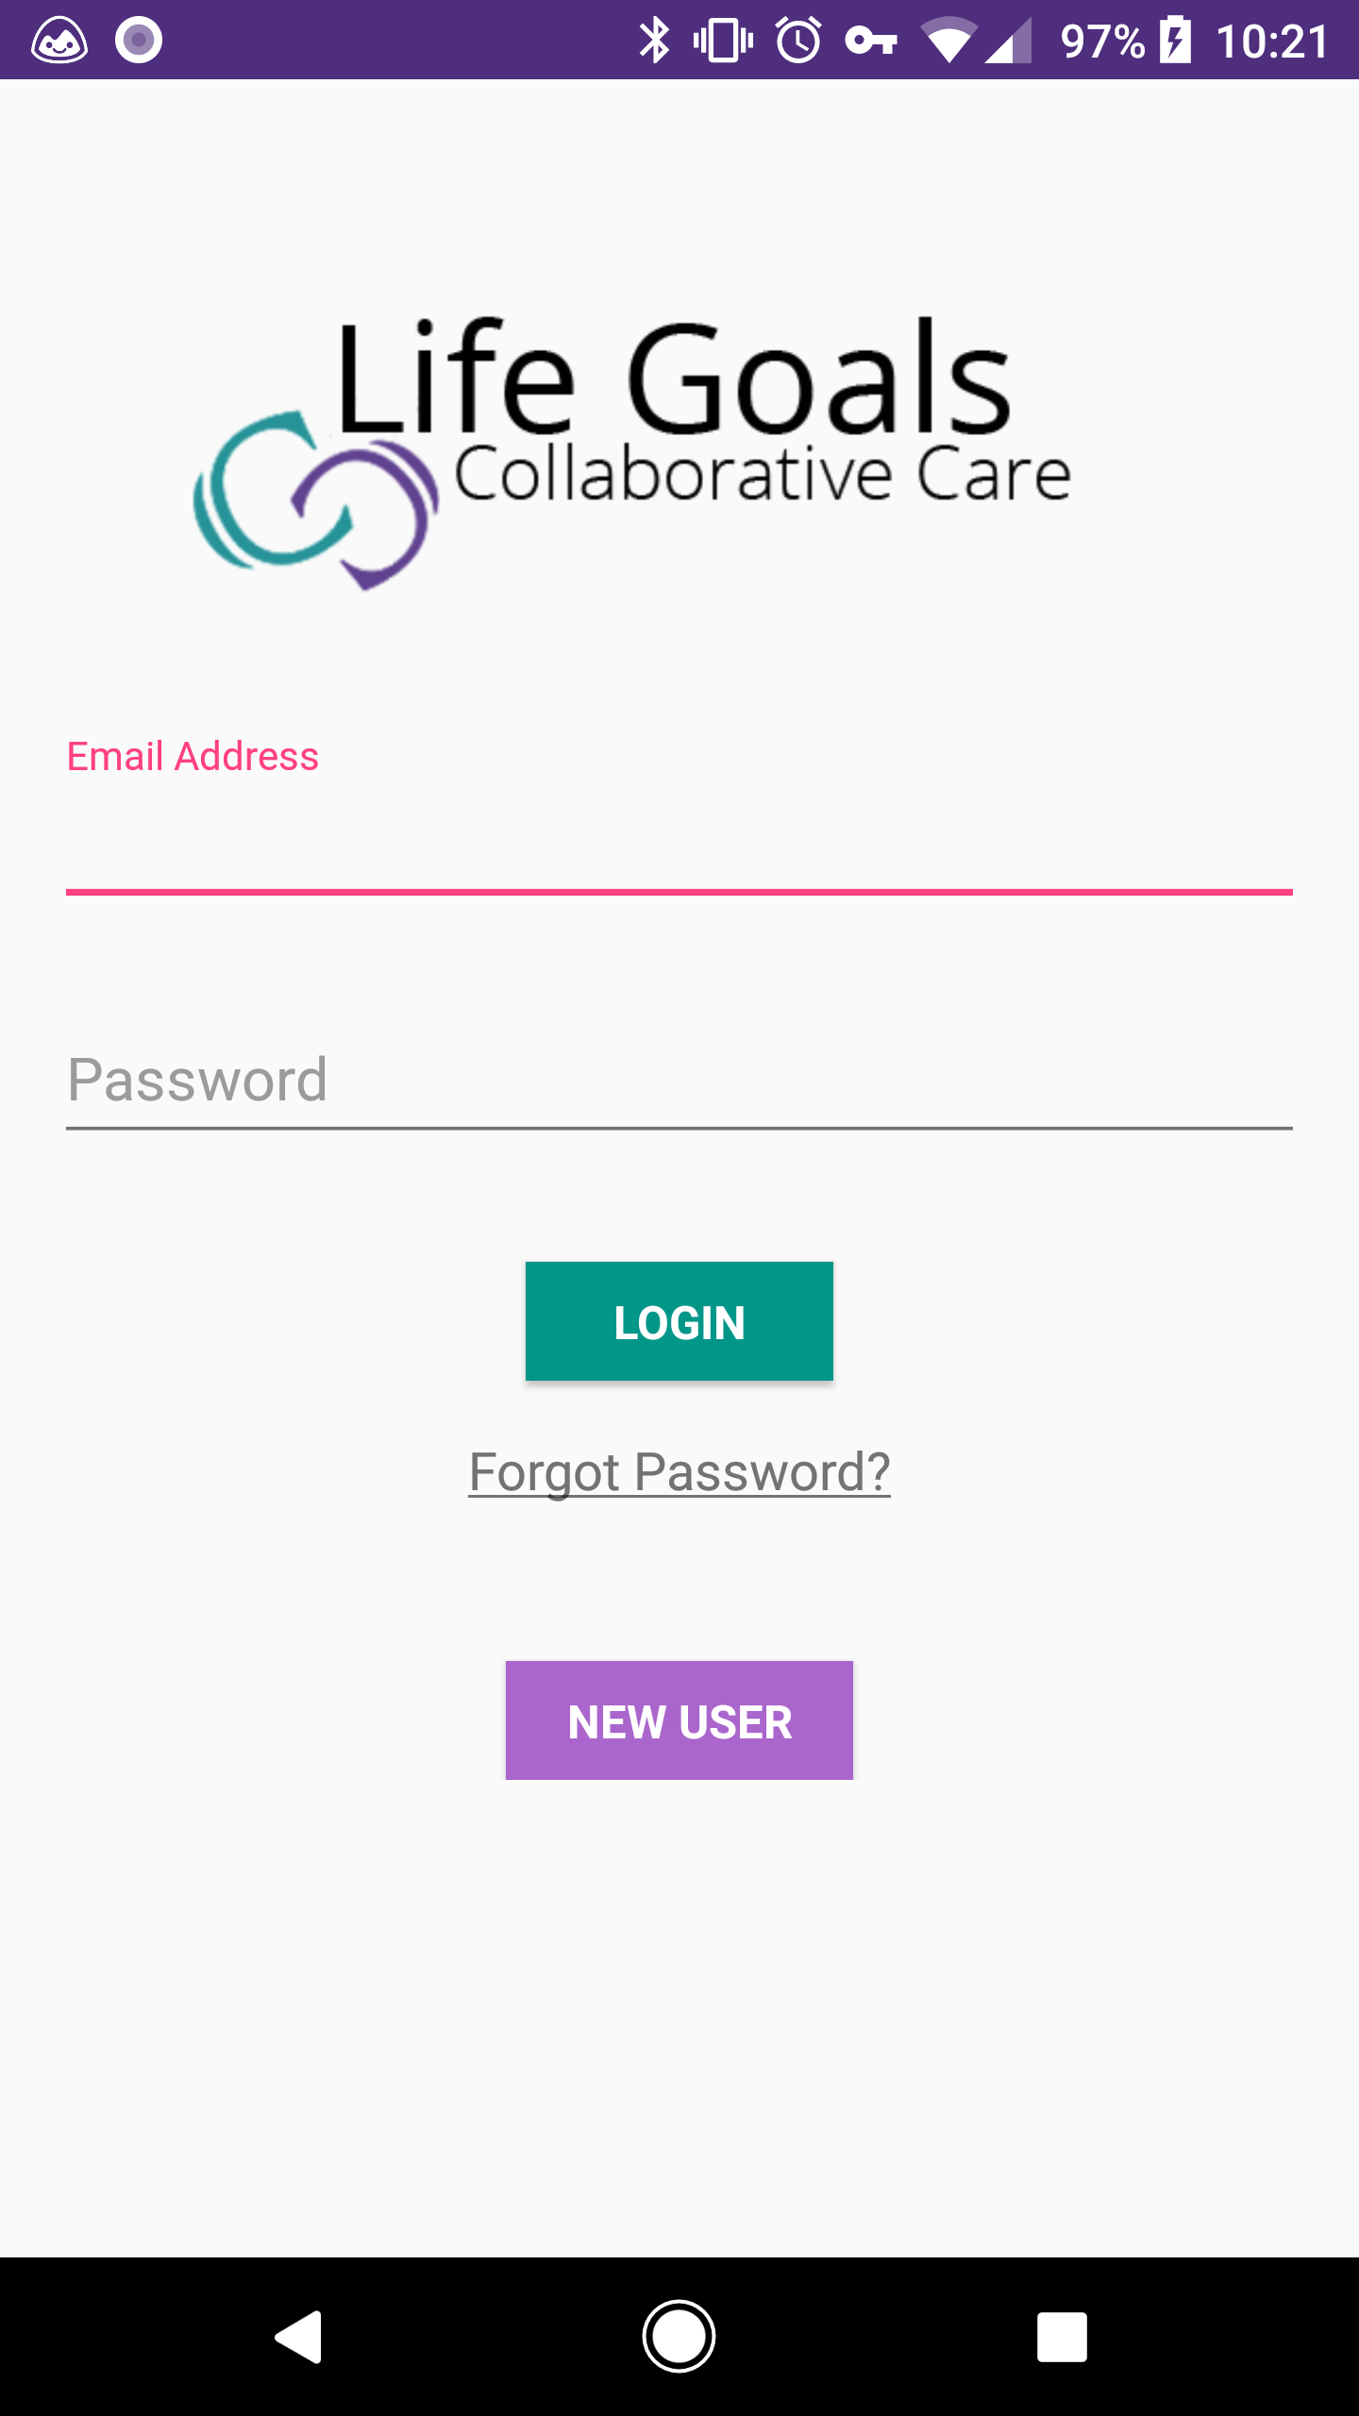
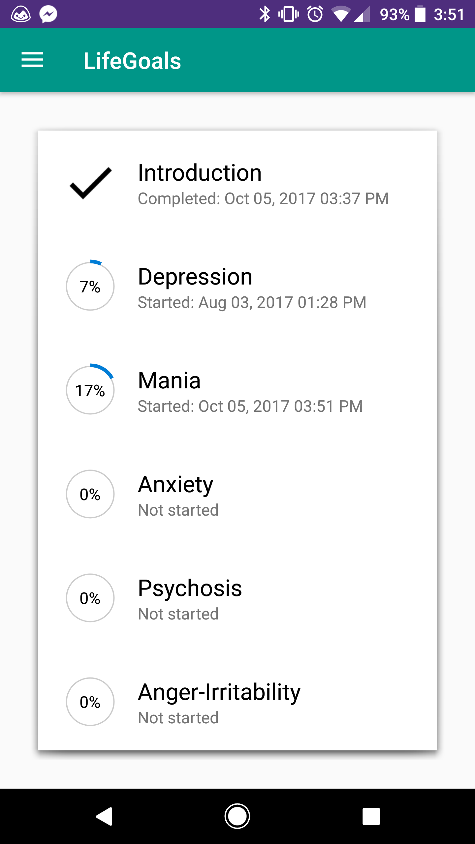
Life Goals App Screenshots

Slide 7
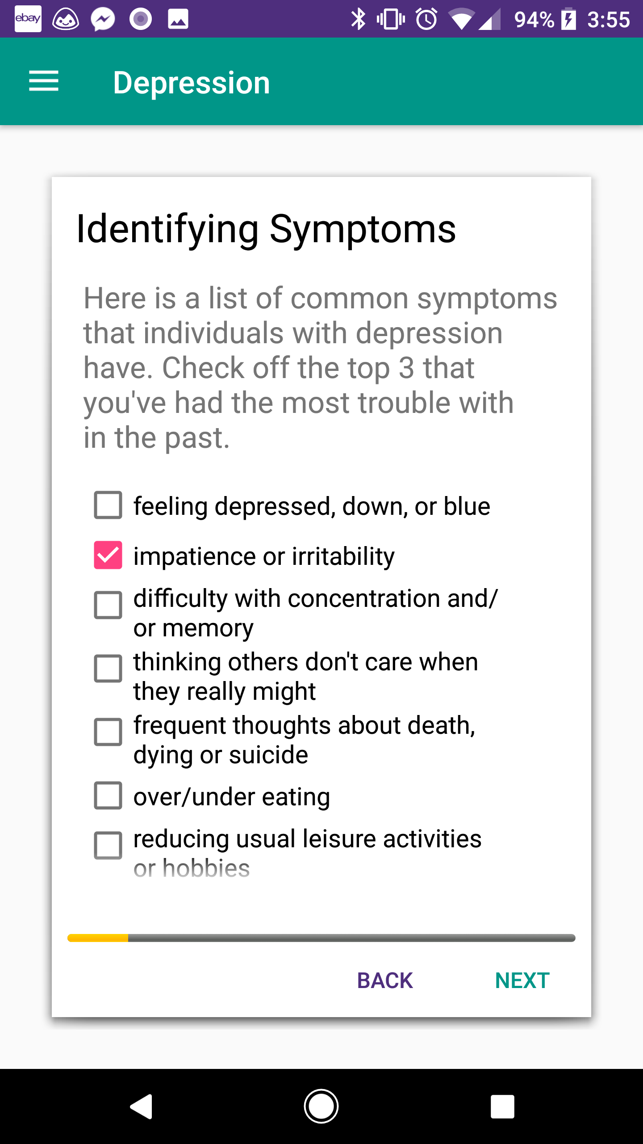
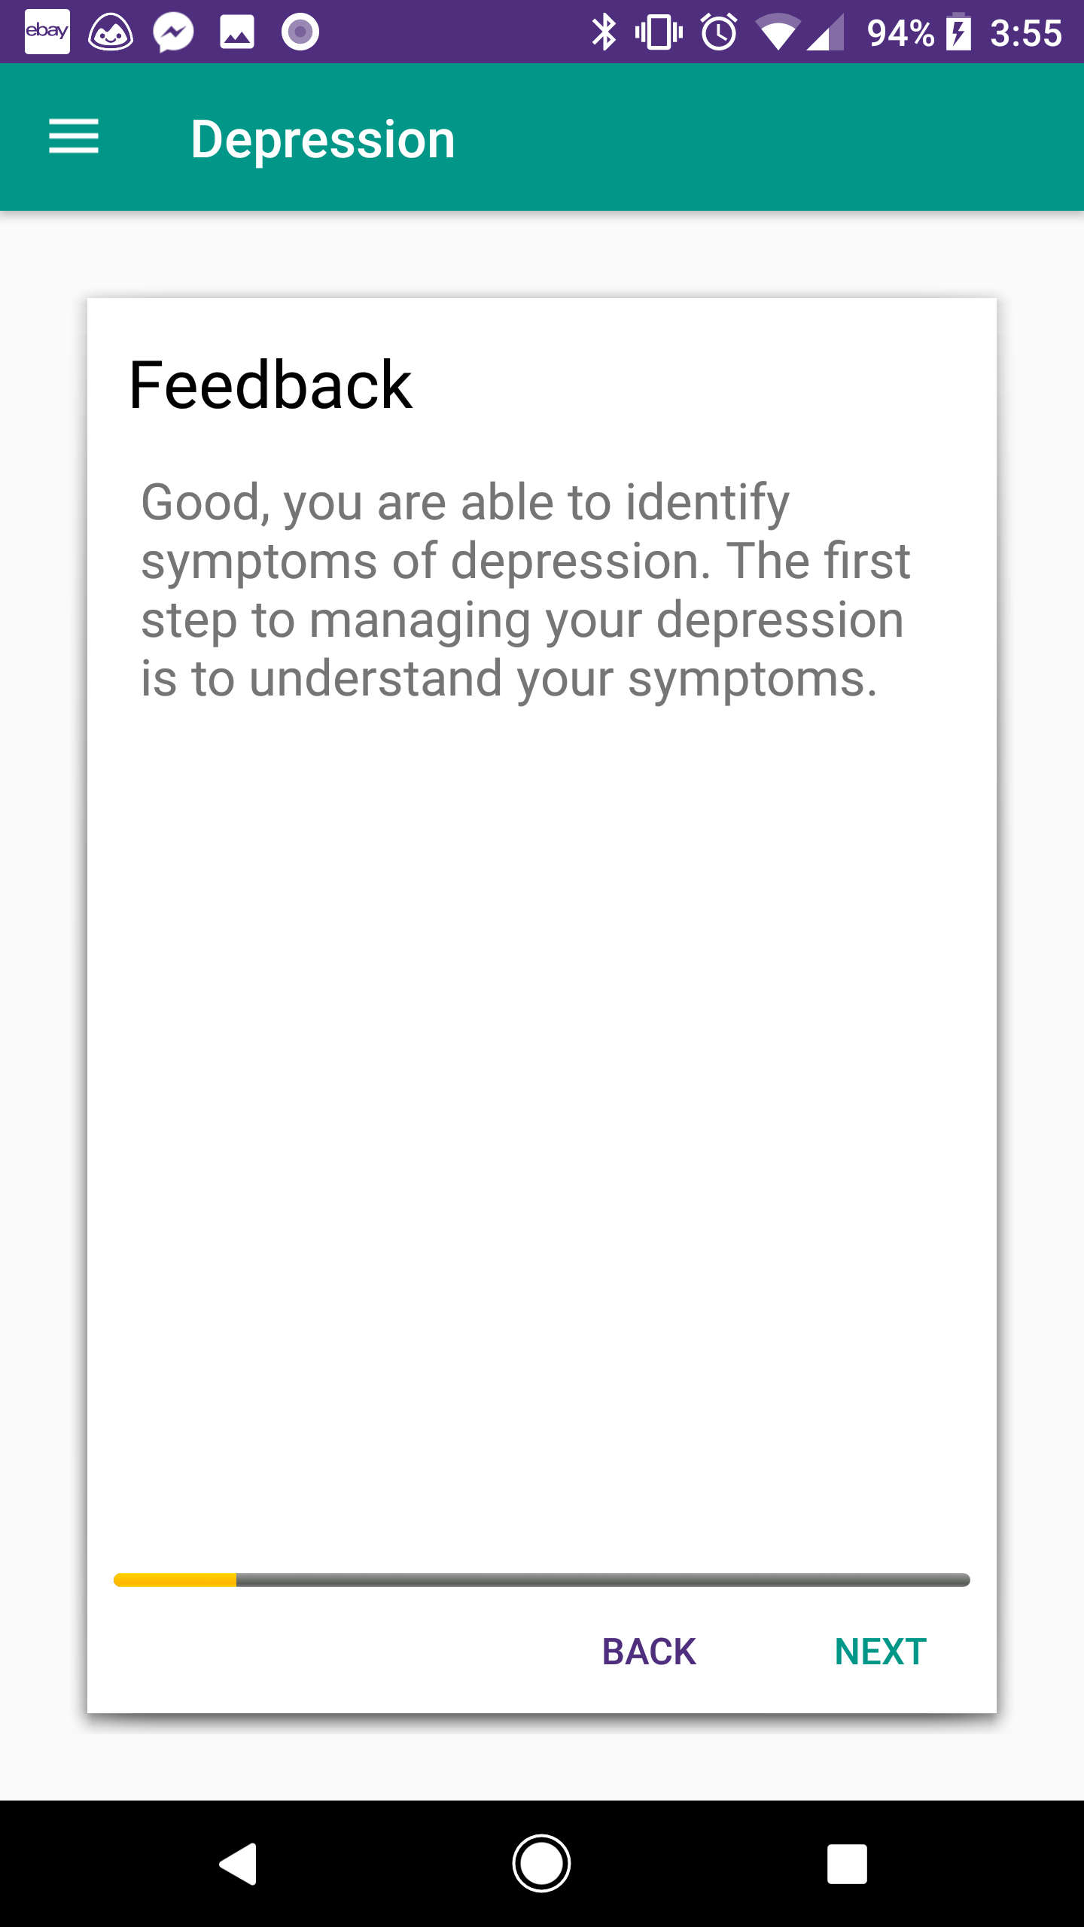
Life Goals App Screenshots

Slide 8
Objective 1 Activity 1 - Refine Life Goals and PRIORI apps
October 2017: Continue work with Arbormoon to refine apps
November 2017: New icon for Life Goals app that includes the UM and Life Goals logos
December 2017: Life Goals app moved to production server and beta testing continues; IRB under core committee review; contract with Arbormoon amended to continue the maintenance with Life Goals and PRIORI
February 2018: Life Goals app listed on the Google Play Store

Slide 9
Future Activities
Objective 1: Refine the Life Goals and PRIORI apps for use among consumers served by Medicaid
Activity 1 – Continue to work with Arbormoon to refine and beta test Life Goals and PRIORI apps
Activity 2 – Create an access point to PRIORI from the Life Goals app
Objective 2: Identify and recruit local CMHs as sites to disseminate Life Goals/PRIORI apps to consumers with bipolar disorder
Activity 1 – Recruit one more CMH to participate in app dissemination
Activity 2 – Disseminate apps to participating CMHs
Objective 3: To determine if app use impact bipolar disorder symptoms and functioning
Activity 1 – Once IRB approval is received, begin recruitment and enrollment of consumers

